Slide 1

“Gesture and Voice controlled Virtual Mouse"
Vijaya Vittala Institute Of Technology, Bangalore
Department of Computer Science and Engineering
Phase 2 Presentation on:
Submitted by:
Mohammed Izhaar Ul Haq (1VJ19CS033)
Mohammed Jabir (1VJ19CS034)
Mohammed Thareem (1VJ19CS035)
Musavveer Rehaman M K (1VJ19CS037)
Under Guidance of:
Dr. Naveen G

Slide 2
Table of Contents
Abstract
Problem Statement
Existing System
Objectives of Proposed System
Features
Methodology for Gesture Control
Data Flow Diagram
Applications
Future Scope
Conclusions
Reference

Slide 3
Abstract
This project takes forward the approach of the Human Computer Interaction (HCI) by controlling cursor movement through hand movement and voice commands using a real-time camera and microphone.
Virtual mouse acts as a contactless mouse, thus can be more useful and time saving.
Specially abled people with some problem in their hands can use this virtual mouse to control the mouse functions in the computer.
Can be used used for distance controlling of systems in robots, classrooms, war emunisions, AR and VR game, etc.

Slide 4
Problem Statement
To design motion tracking mouse which detect finger movements gestures instead of physical mouse.
The camera should detect all the motions of hand and performs the operation of mouse.
Implement such code where motion tracker mouse has drag & drop feature along with scrolling feature.
User Interface must be Simple & easy to understand.

Slide 5
Existing System
Physical mouse is subjected to mechanical wear and tear.
Physical mouse requires special hardware and surface to operate.
Physical mouse is not easily adaptable to different environments and its performance varies depending on the environment.
All wired mouse and wireless mouse have its own lifespan.
Physical mouse is not easily adaptable to different environments and its performance varies depending

Slide 6
Objective of Proposed System
Design for operation of a mouse with the help of a webcam which is responsible for capturing the video in real-time.
Convert hand gesture/motion into mouse function and the cursor is set to a particular screen position. The Virtual Mouse application is programmed to detect the position of ﬁngertips and knuckles where it will be set as the position of the mouse pointers.
Develop a multi user independent speech recognition system that captures voice in real-time with the help of a microphone and is able to retrieve folders, sub-folders, documents, copy, paste, left click, right click and double click by taking voice command and checking its validity.
Design a voice controlled mouse system that is integrated with the gesture controlled system.

Slide 7
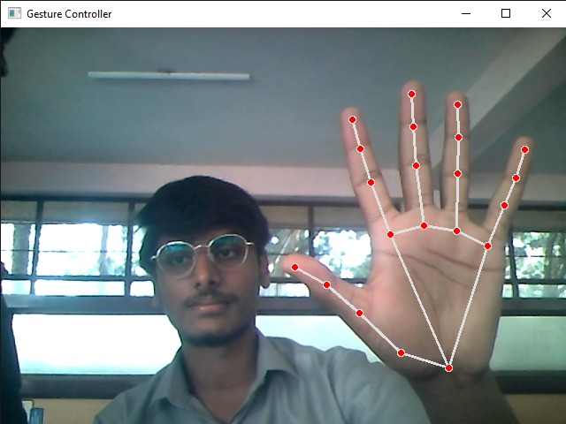
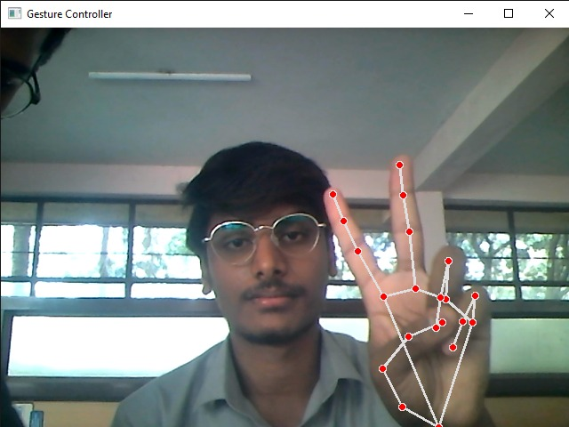
Features
Gesture Control
Move Cursor
Left Click
Right Click
Double Click
Scrolling
Drag and Drop
Multiple Item Selection
Volume Control
Brightness Control
Neutral
Move Cursor

Slide 8
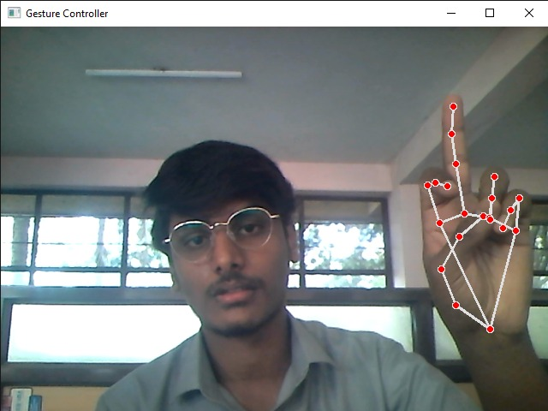
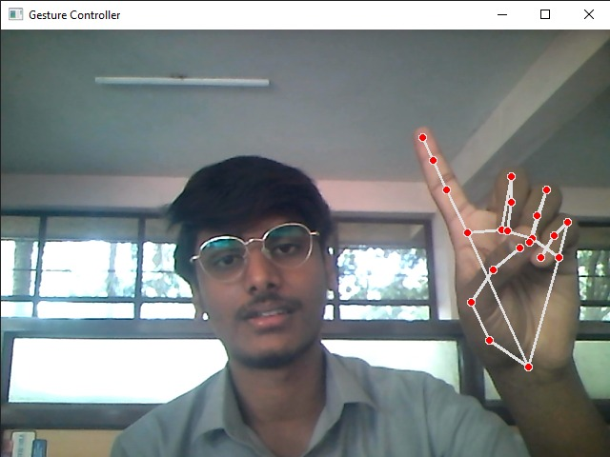
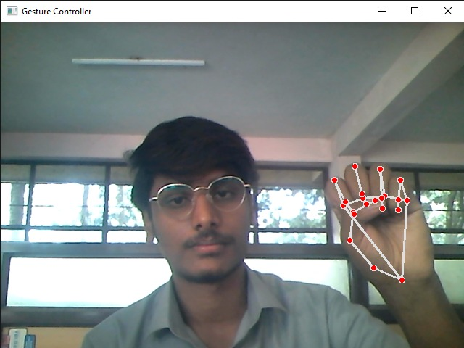
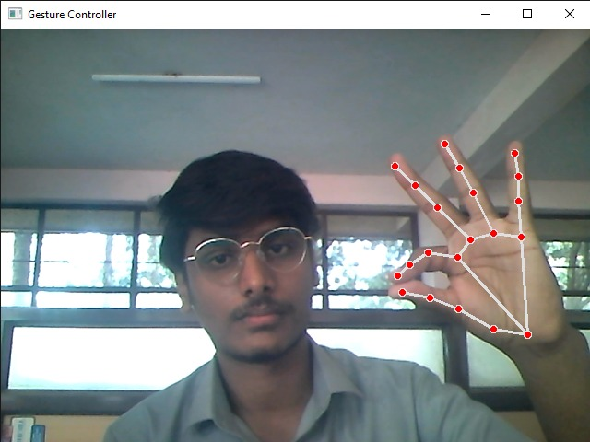
Left Click
Right Click
Double Click
Drag and Drop
Volume Control

Slide 9
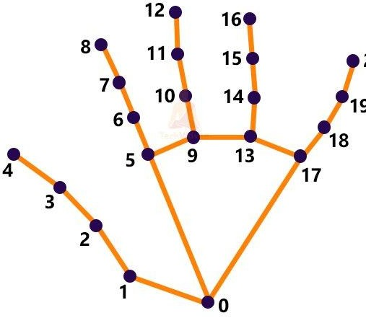
Methodology for Gesture Control
Computer Vision technology is applied for Object identiﬁcation and object video capturing in BGR format which is done by OpenCV.
Captured hand object processed by MediaPipe using two models-
Palm Detection Model (KNN algorithm)
Hand Landmark Model
MediaPipe renders 21 coordinates located on a detected hand in a 2.5D space as an output.

Slide 10
Methodology for Gesture Control
Subsequently ids are assigned to each ﬁnger of the right hand in the rendered output landmark.
Corresponding coordinated of all the required ids are calculated and different operations are performed based on the distances and angles between the points
In order for the mouse to perform a left click:
In the ﬁrst frame, the index ﬁnger with Tip ID 1 and the middle ﬁnger with Tip ID 2 must be up, followed by Index Finger (Tip Id 1) down and Middle ﬁnger (Tip id2) up in the second frame, with both producing an angle greater than 33.5°.

Slide 11
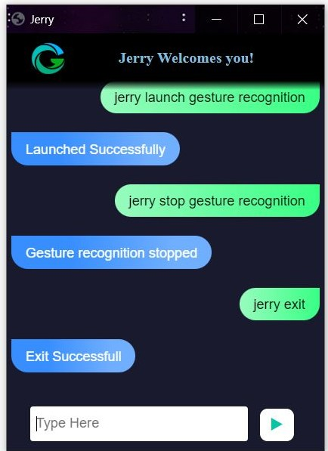
Methodology
Voice Controller
Launch Jerry on your monitor (Jerry - name of our voice assistant)
Give command to be followed.
Speech_recognition library detects your speech and jerry will perform the operations as given in the next slide.

Slide 12
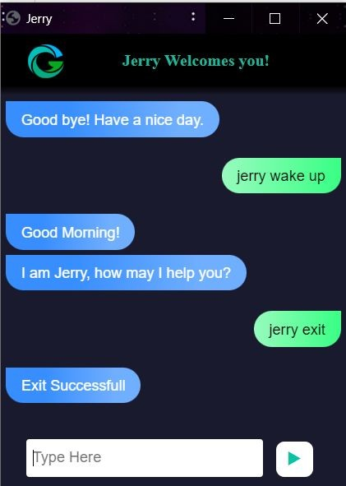
Features
Voice Control
Launch/stop gesture recognition
Google search
Find a location on Google map
File navigation
Current date and time
Copy and paste
Sleep/Wakeup App
Exit

Slide 13
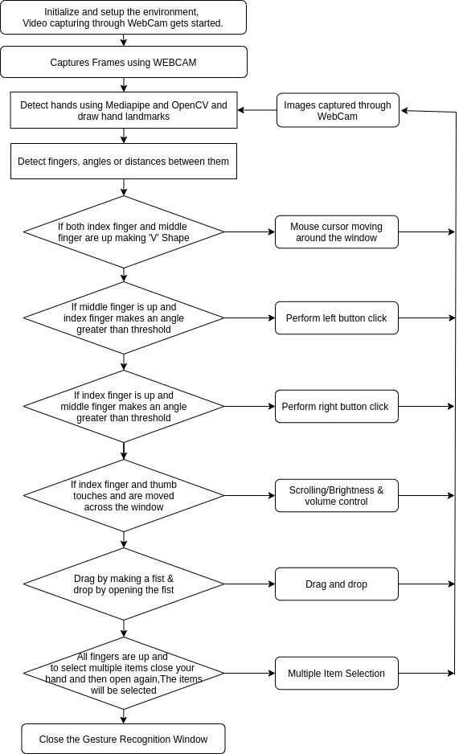
Data Flow Diagram
Gesture Control

Slide 14
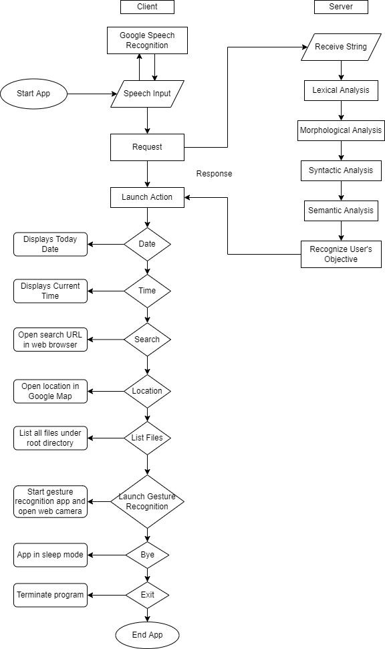
Data Flow Diagram
Voice Control

Slide 15
Applications
Can reduce physical stress on the body that is responsible for causing back pain, weak eyesight, posture defect, etc.
Can be used used for distance controlling of systems in robots, classrooms, war emunisions, AR and VR game, etc.
Amidst the transmitted diseases when it is unsafe to use the devices by touching, the proposed virtual mouse can be used to control the PC mouse functions hand free.
Virtual mouse can be used to play virtual reality and augmented reality based games without the wireless or wired mouse devices

Slide 16
Future scope
Virtual Mouse will soon be introduced to replace the physical computer mouse to promote convenience while still being able to accurately interact and control the computer system.
More features such as enlarging and shrinking window, closing windows, etc can be added by using palm and multiple ﬁngers.
Better efﬁciency of gesture recognition can be achieved when it can detect hand gestures in different types of lightings, different hand complexions and distance from camera.
Virtual mouse can be designed to perform other complex tasks such as doing calculations by verbal commands etc.

Slide 17
Hardware & Software requirements (minimum)-
Web Cam: 1.3 megapixel resolution
Processor : Core2Duo (2nd generation)
Main Memory : 2GB RAM
Hard Disk : 320GB
Microphone
Python
OpenCV
MediaPipe

Slide 18
Conclusion
The main objective of the virtual mouse system is to control the mouse cursor functions by using hand gestures and voice commands instead of using a physical mouse.
The proposed virtual mouse system performs well and has greater accuracy compared to the existing models and also the model overcomes most of the limitations of the existing systems.
Virtual mouse can be used for real-world applications. Since the proposed mouse system can be used virtually using hand gestures and voice commands, it can be useful in preventing the spread of COVID-19. Virtual mouse can be very useful to specially abled people
It can help in simplifying user interactions with personal computers and hardware systems. It can create possibility of distance controlling of robots, AR and VR etc.

Slide 19
References
Roshan Hyalij, Siddharth Oturkar, Atharv Kasodekar , Varun Kothawade, Kamlesh Patil, Prof.Aashutosh Kale, ‘’ Virutal Mouse Application ’’
N. Subhash Chandra, T. Venu, P. Srikanth, “A Real-Time Static & Dynamic Hand Gesture Recognition System” International Journal of Engineering Inventions Volume 4, Issue 12
S. Shiriam, B. Nagaraj, J. Jaya, “Machine Learning based real time AI Virtual Mouse system using computer vision to avoid COVID-19 spread”, Hindawi Journal of Healthcare Engineering
Hritik Joshi, Nitin Waybhase, Ratnesh Litoria, “Towards controlling mouse through hand gestures: A novel and efﬁcient approach”, Medi-caps University
Mohhamad Raﬁ, Khan Sohail, Shaikh Huda, “Control mouse and computer system using voice commands”, International Journal of Research in Engineering and Technology”, Volume 5, Issue 3

Slide 20
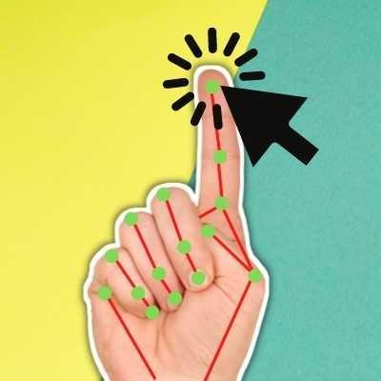
Thank You!

